Slide 1
Chapter 2
Application Layer
2-<number>

Slide 2
Chapter 2: Application layer
2.1 Principles of network applications
2.7 Socket programming with TCP
2.8 Socket programming with UDP
2.3 FTP
2.2 Web and HTTP
2.9 Building a Web server
2.5 DNS
2.6 P2P file sharing
2-<number>

Slide 3
Chapter 2: Application Layer
Our goals:
conceptual, implementation aspects of network application protocols
  transport-layer service models
  client-server paradigm
  peer-to-peer paradigm
programming network applications
  socket API
learn about protocols by examining popular application-level protocols
  HTTP
  FTP
  DNS
2-<number>

Slide 4
Chapter 2: Application layer
2.1 Principles of network applications
2-<number>

Slide 5





Creating a network app
Write programs that
  run on different end systems and
  communicate over a network.
  e.g., Web: Web server software communicates with browser software
No software written for devices in the core network
  core network devices do not function at app layer
  This design allows for rapid app development
application
transport
network
data link
physical
application
transport
network
data link
physical
application
transport
network
data link
physical
2-<number>

Slide 6
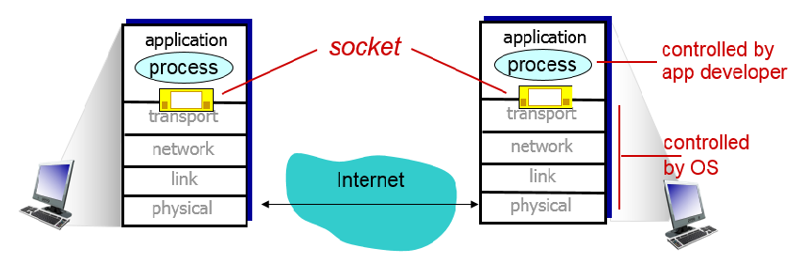
Processes communicating: Sockets
process sends/receives messages to/from its socket
socket analogous to door
  sending process shoves message out door
  sending process relies on transport infrastructure on other side of door which brings message to socket at receiving process
  For a process to receive messages, it must have an identifier
  Identifier includes both the IP address and port numbers associated with the process on the host.
API: (1) choice of transport protocol; (2) ability to fix a few parameters such as max. buffer and segment sizes
2-<number>

Slide 7
What transport service does an app need?
Application service requirements:
Data loss
some apps (e.g., audio) can tolerate some loss
other apps (e.g., file transfer, telnet) require 100% reliable data transfer
Bandwidth
some apps (e.g., multimedia) require minimum amount of bandwidth to be “effective”
other apps (“elastic apps”) make use of whatever bandwidth they get
Timing
some apps (e.g., Internet telephony, interactive games) require low delay to be “effective”
Security
encryption, data integrity, …
2-<number>

Slide 8
Chapter 2: Application layer
2.7 Socket programming with TCP
2-<number>

Slide 9
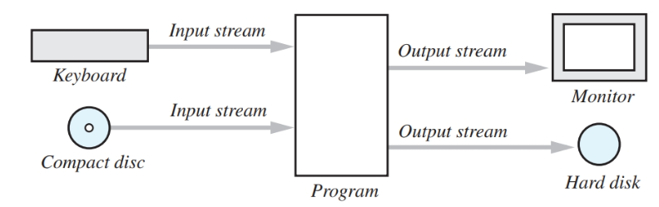
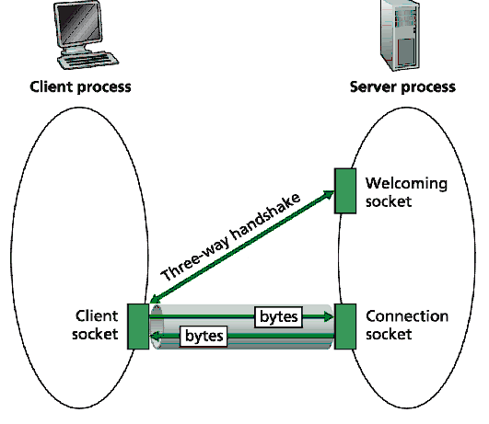
Socket programming with TCP
Server process must first be running and have created socket (door) that welcomes client’s contact
Client contacts server by:
creating client-local TCP socket
specifying IP address, port number of server process
When client creates socket: client TCP establishes connection to server TCP
When server is contacted by client, server creates new socket for server process to communicate with client
  allows server to talk with multiple clients
  source port numbers used to distinguish clients
Net Socket
Net Socket
2-<number>

Slide 10
Stream jargon
A stream is a sequence of characters that flow into or out of a process.
An input stream is attached to some input source for the process, eg, keyboard or socket.
An output stream is attached to an output source, eg, monitor or socket.
2-<number>

Slide 11

Example: Client-Server Echo app Socket programming with TCP
Client-Server Echo app:
1) client reads line from standard input (inFromUser stream) , sends to server via socket (outToServer stream)
2) server reads line from socket
3) server converts line to uppercase, sends back to client
4) client reads, prints modified line from socket (inFromServer stream)
Client
process
client TCP socket
2-<number>

Slide 12
Example: Java client (TCP)
import java.io.*;
import java.net.*;
import java.util.Scanner;
class TCPClient {
public static void main(String argv[]) throws Exception
{
String sentence;
String modifiedSentence;
Socket clientSocket = new Socket("hostname", 6789);
Scanner inFromUser = new Scanner(System.in);
PrintWriter outToServer =
new PrintWriter(clientSocket.getOutputStream(), true);
Scanner inFromServer =
new Scanner(clientSocket.getInputStream());
Create
client socket,
connect to server
Create
input stream
Create
output stream
attached to socket
Create
input stream
attached to
socket
2-<number>

Slide 13
Example: Java client (TCP), cont.
sentence = inFromUser.nextLine();
outToServer. println(sentence);
modifiedSentence = inFromServer.nextLine();
System.out.println("FROM SERVER: " + modifiedSentence);
clientSocket.close();
}
Send line
to server
Read line
from server
Close the
clientSocket
2-<number>

Slide 14
Example: Java server (TCP)
import java.io.*;
import java.net.*;
import java.util.Scanner;
class TCPServer {
public static void main(String argv[]) throws Exception
{
String clientSentence;
String capitalizedSentence;
ServerSocket welcomeSocket = new ServerSocket(6789);
while(true) {
Socket connectionSocket = welcomeSocket.accept();
Scanner inFromClient =
new Scanner(connectionSocket.getInputStream());
PrintWriter outToClient =
new PrintWriter(connectionSocket.getOutputStream(),true);
Create
welcoming socket
at port 6789
Wait, on welcoming
socket for contact
by client
Create input
stream, attached
to socket
Create output
stream, attached
to socket
2-<number>

Slide 15
Example: Java server (TCP), cont
clientSentence = inFromClient.nextLine();
capitalizedSentence = clientSentence.toUpperCase() + '\n';
outToClient.println(capitalizedSentence);
}
connectionSocket.close();
}
Read in line
from socket
Write out line
to socket
End of while loop,
loop back and wait for
another client connection
Close the
connectionSocket
2-<number>

Slide 16
Chapter 2: Application layer
2.8 Socket programming with UDP
2-<number>

Slide 17
Socket programming with UDP
UDP: no “connection” between client and server
no handshaking
sender explicitly attaches IP address and port of destination to each packet
UDP: transmitted data may be received out of order, or lost
application viewpoint
UDP provides unreliable transfer
of groups of bytes (“datagrams”)
between client and server
2-<number>

Slide 18
Client/server socket interaction: UDP
Server (running on hostid)
Client
create socket,
port=x, for
incoming request:
create socket,
clientSocket =
DatagramSocket()
serverSocket =
DatagramSocket(port x)
Create datagrampkt (hostid, port=x,
datatgram, datagram length)
send datagram request
using clientSocket
read request from
serverSocket
write reply to
serverSocket
specifying client
host address,
port number
read reply from
clientSocket
close
clientSocket
2-<number>

Slide 19

Example: Java client (UDP)
Client
process
Input: receives UDP packet
Output: sends UDP packet
client UDP socket
2-<number>

Slide 20
Example: Java client (UDP)
import java.io.*;
import java.net.*;
import java.util.Scanner;
class UDPClient {
public static void main(String args[]) throws Exception
{
Scanner inFromUser = new Scanner(System.in);
DatagramSocket clientSocket = new DatagramSocket();
InetAddress IPAddress = InetAddress.getByName(“serverhostname");
byte[] sendData = new byte[1024];
byte[] receiveData = new byte[1024];
String sentence = inFromUser.nextLine();
sendData = sentence.getBytes();
Create
input stream
Create
client socket
Translate
hostname to IP
address
2-<number>

Slide 21
Example: Java client (UDP), cont.
Create datagram with data-to-send,
length, IP addr, port
DatagramPacket sendPacket =
new DatagramPacket(sendData, sendData.length, IPAddress, 9876);
clientSocket.send(sendPacket);
DatagramPacket receivePacket =
new DatagramPacket(receiveData, receiveData.length);
clientSocket.receive(receivePacket);
String modifiedSentence =
new String(receivePacket.getData());
System.out.println("FROM SERVER:" + modifiedSentence);
clientSocket.close();
}
}
Send datagram
to server
Read datagram
from server
2-<number>

Slide 22
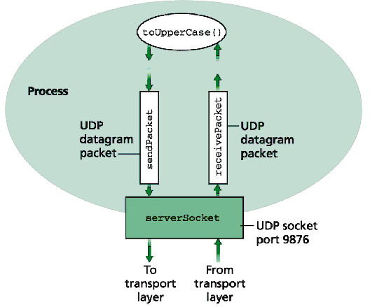
Example: Java server (UDP)
2-<number>

Slide 23
Example: Java server (UDP)
import java.io.*;
import java.net.*;
class UDPServer {
public static void main(String args[]) throws Exception
{
DatagramSocket serverSocket = new DatagramSocket(9876);
byte[] receiveData = new byte[1024];
byte[] sendData = new byte[1024];
while(true)
{
DatagramPacket receivePacket =
new DatagramPacket(receiveData, receiveData.length);
serverSocket.receive(receivePacket);
Create
datagram socket
at port 9876
Create space for
received datagram
Receive
datagram
2-<number>

Slide 24
Example: Java server (UDP), cont
String sentence = new String(receivePacket.getData());
InetAddress IPAddress = receivePacket.getAddress();
int port = receivePacket.getPort();
String capitalizedSentence = sentence.toUpperCase();
sendData = capitalizedSentence.getBytes();
DatagramPacket sendPacket =
new DatagramPacket(sendData, sendData.length, IPAddress,
port);
serverSocket.send(sendPacket);
}
}
}
Get IP addr
port #, of
sender
Create datagram
to send to client
Write out
datagram
to socket
End of while loop,
loop back and wait for
another datagram
2-<number>

